Slide 1
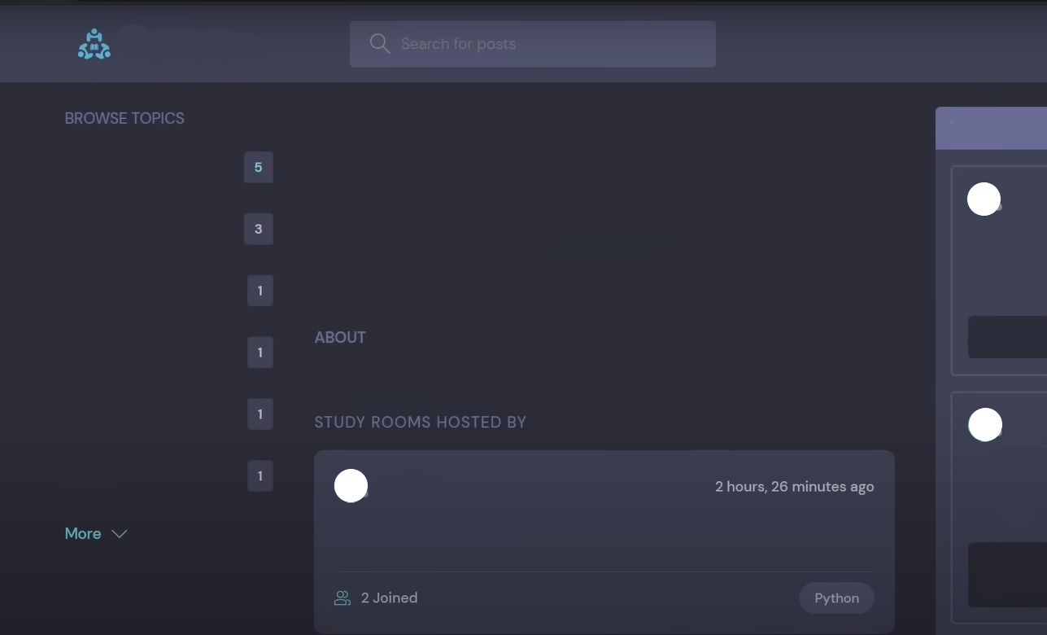
Foram
A Structured Platform for Focused Discussion

Slide 2
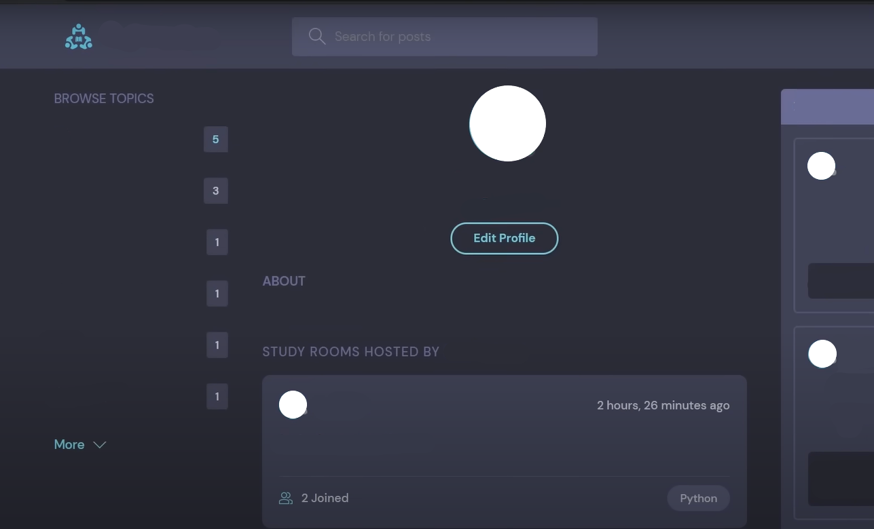
Foram
Pradyumna Rajnekar
@prarx
A Structured Platform for Focused Discussion
@prarx
Hey There!

Slide 3
Foram
Pranay Khandelwal
@pranay31aug
A Structured Platform for Focused Discussion
@pranay31aug
Hey There!

Slide 4
Foram
Lack of structured platforms for focused discussions.
Overwhelming unrelated content leads to fragmented interactions.
Current Challenge
Negative impact on students, professionals, and project collaborators.
@newuser123
Hey There!

Slide 5
Foram
Create a web application for dedicated discussions on specific topics.
Objective
Enhance productivity and foster meaningful interactions.
@newuser123
Hey There!

Slide 6
Foram
search functionality
Discussion Rooms
Key Features
@newuser123
Hey There!
User Management

Slide 7
Foram
Intuitive UI
Responsive Design
User Experience
@newuser123
Hey There!

Slide 8

Foram
Technology Stack
SQLite
Django
HTML
CSS
JavaScript
@newuser123
Security Measures!!

Slide 9
Foram
THANK YOU!
Foram aims to create a focused, organized space for discussions, improving user experience and productivity
@prarx & @pranay31aug
Thank You!

